Slide 1
Game Development & Game Engine
© B.Very Christioko, S.Kom

Slide 2
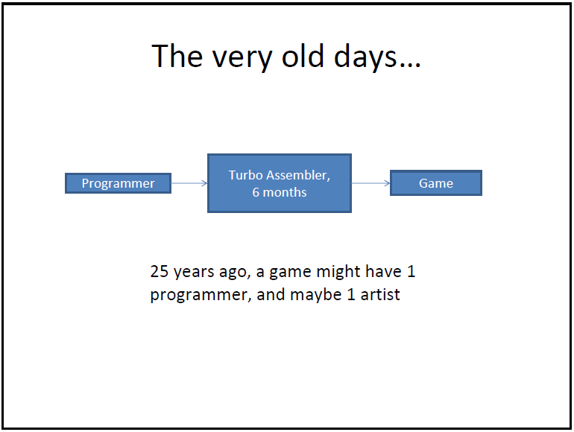
© B.Very Christioko, S.Kom

Slide 3
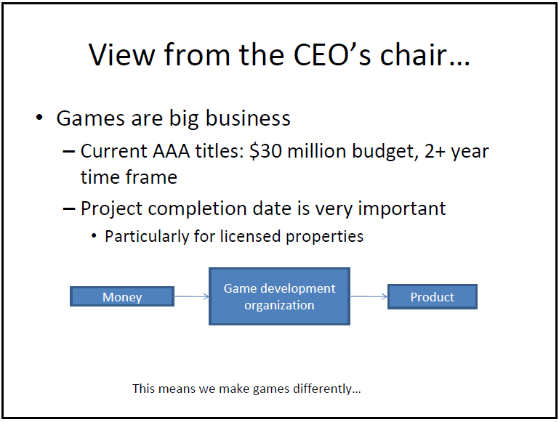
© B.Very Christioko, S.Kom

Slide 4
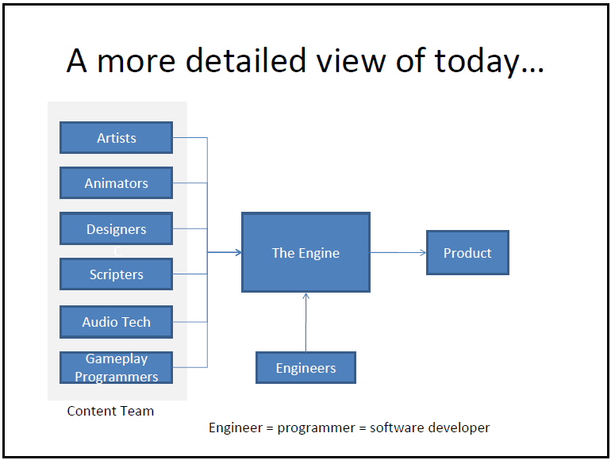
© B.Very Christioko, S.Kom

Slide 5
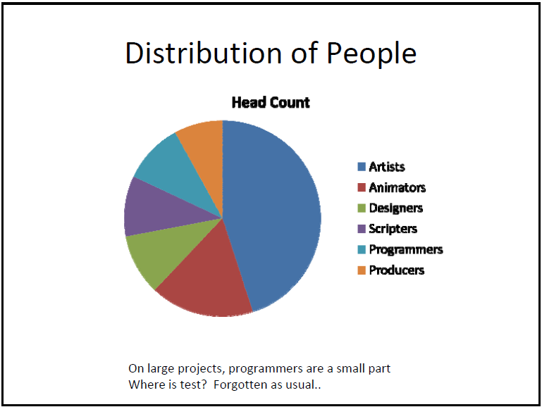
© B.Very Christioko, S.Kom

Slide 6
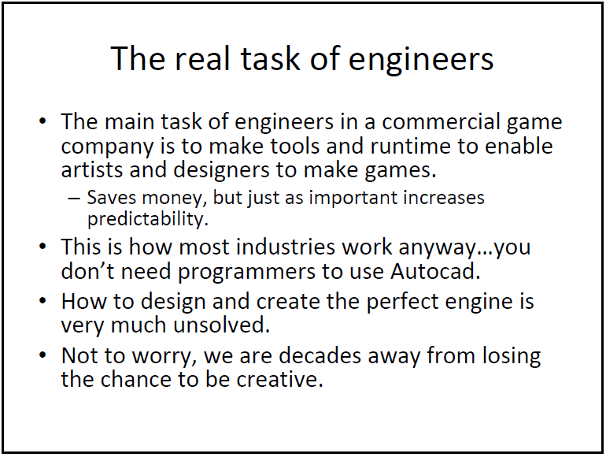
© B.Very Christioko, S.Kom

Slide 7
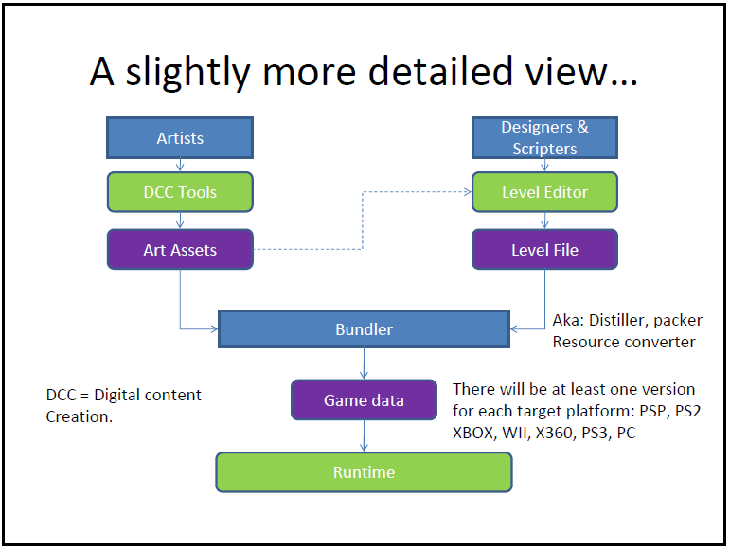
© B.Very Christioko, S.Kom

Slide 8
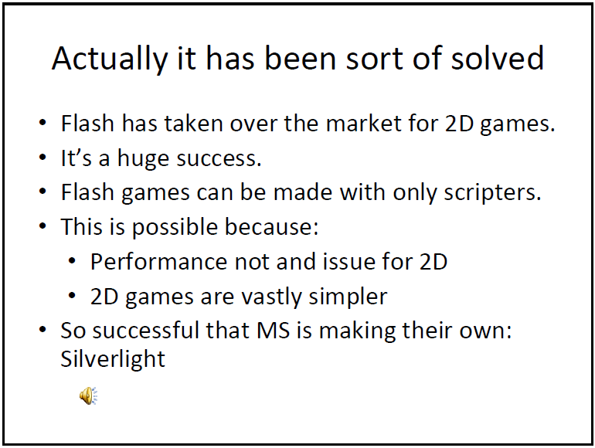
© B.Very Christioko, S.Kom

Slide 9
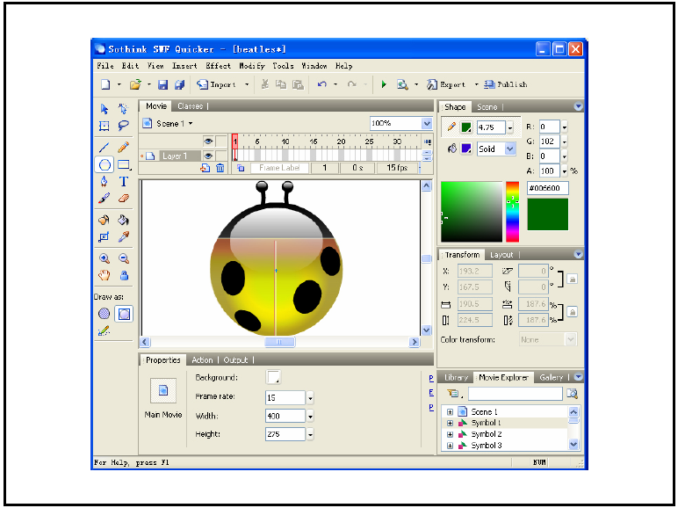
© B.Very Christioko, S.Kom

Slide 10
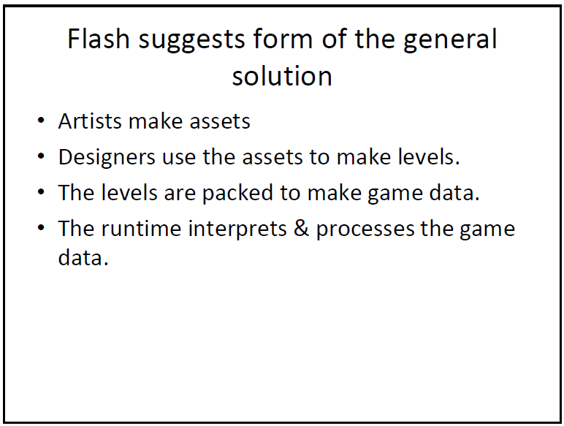
© B.Very Christioko, S.Kom

Slide 11
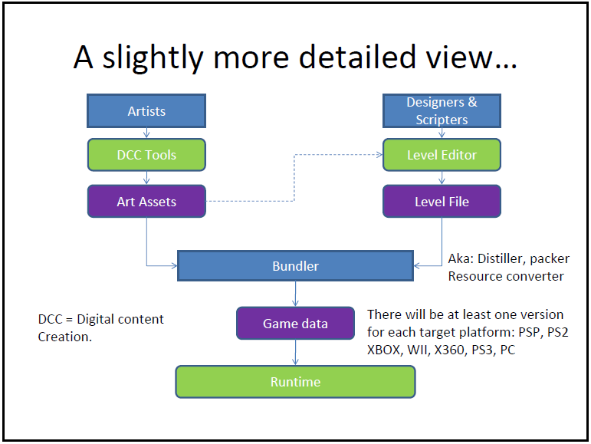
© B.Very Christioko, S.Kom

Slide 12
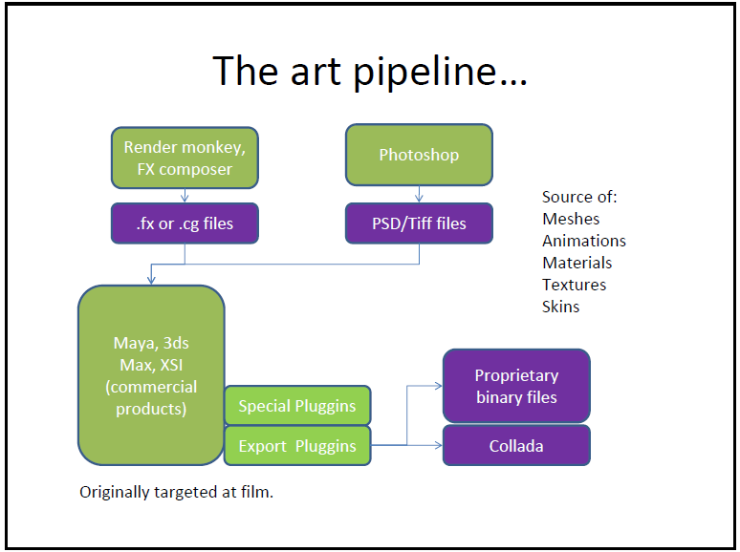
© B.Very Christioko, S.Kom

Slide 13
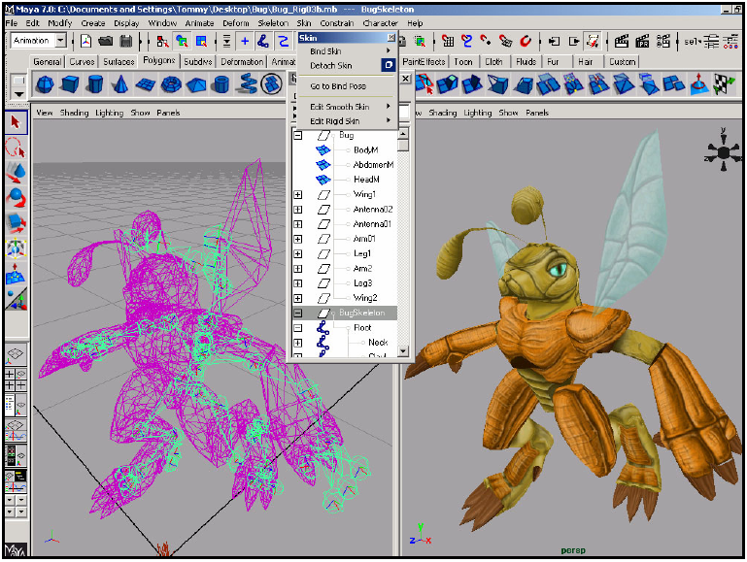
© B.Very Christioko, S.Kom

Slide 14
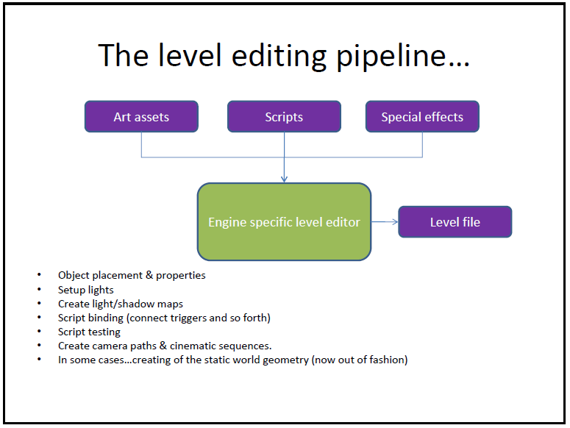
© B.Very Christioko, S.Kom

Slide 15
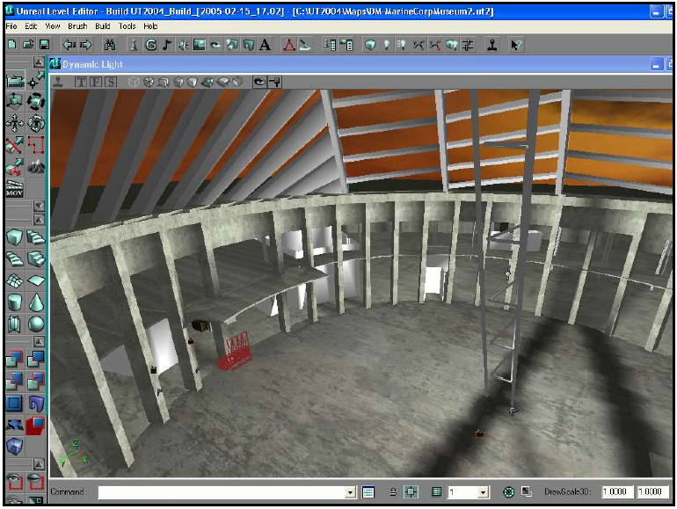
© B.Very Christioko, S.Kom

Slide 16
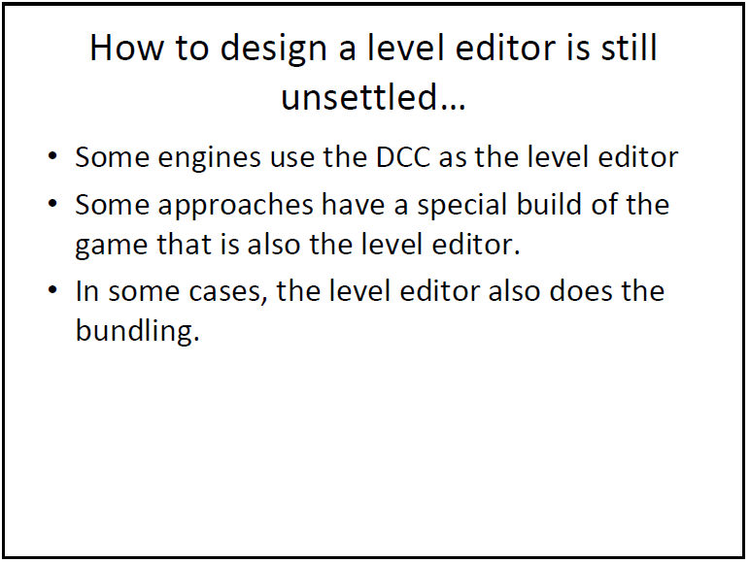
© B.Very Christioko, S.Kom

Slide 17
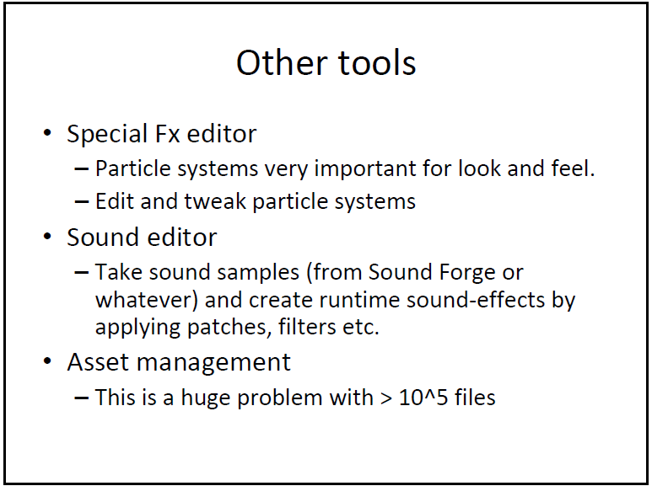
© B.Very Christioko, S.Kom

Slide 18
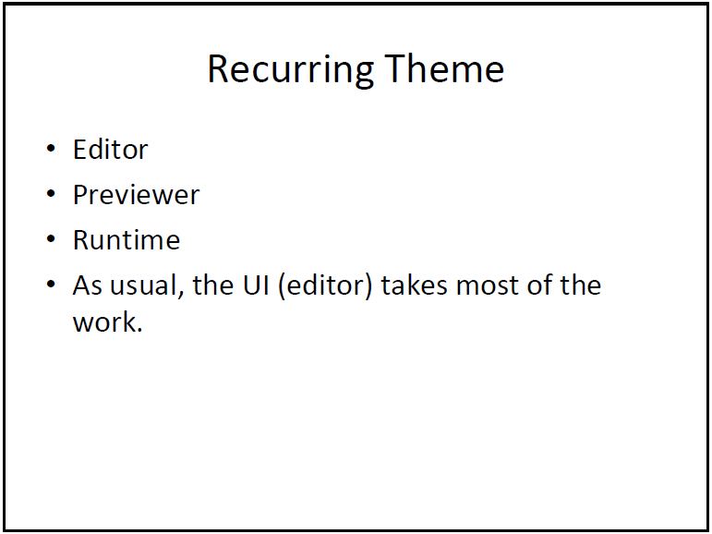
© B.Very Christioko, S.Kom

Slide 19
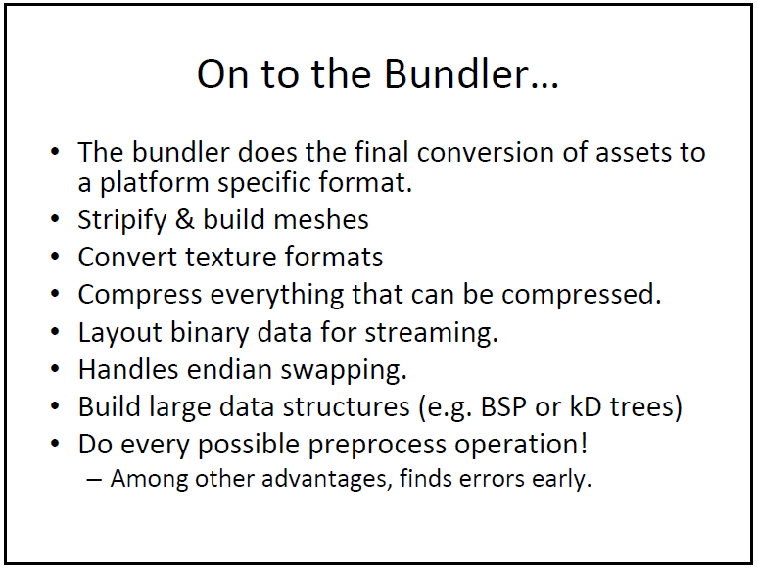
© B.Very Christioko, S.Kom

Slide 20
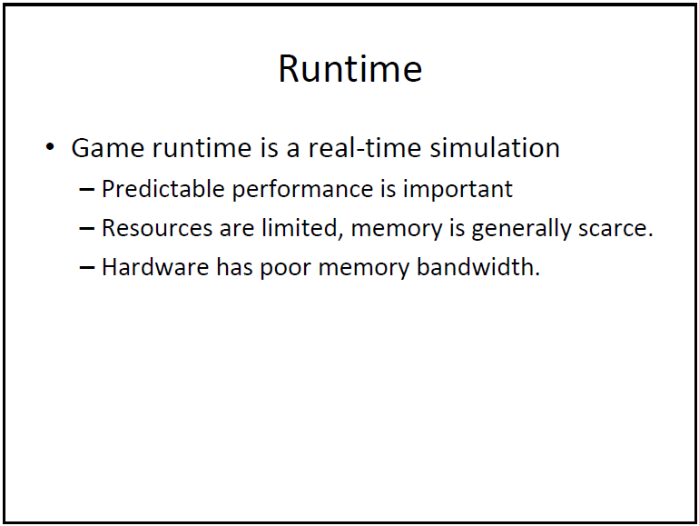
© B.Very Christioko, S.Kom

Slide 21
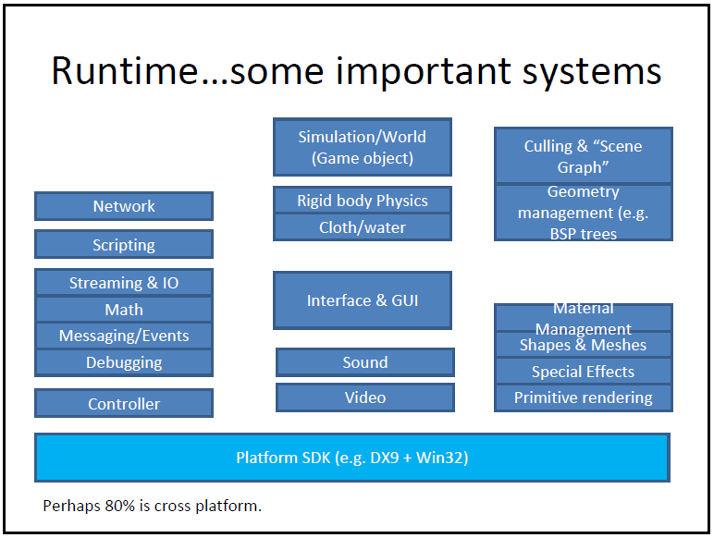
© B.Very Christioko, S.Kom

Slide 22
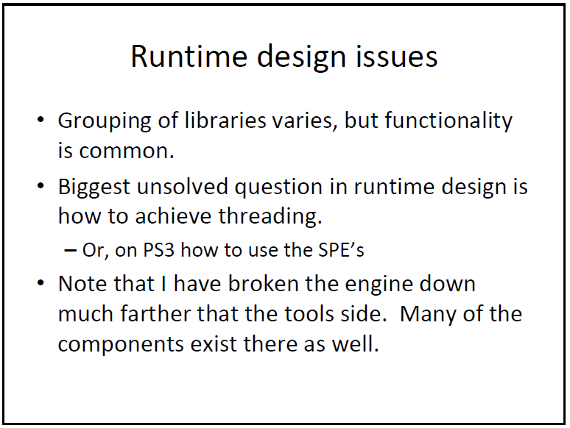
© B.Very Christioko, S.Kom

Slide 23
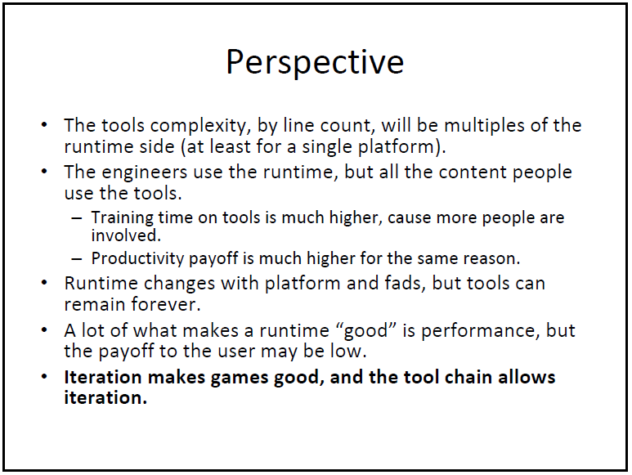
© B.Very Christioko, S.Kom

Slide 24
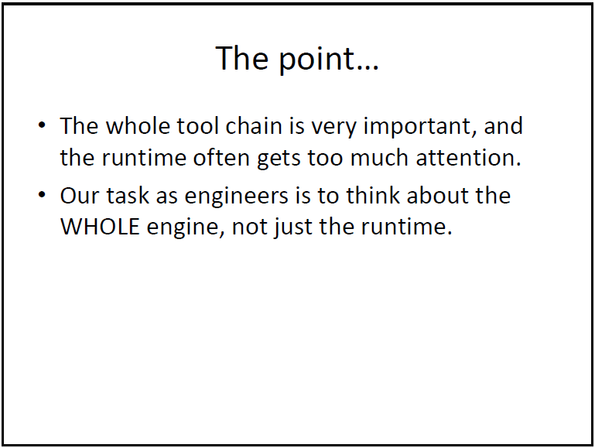
© B.Very Christioko, S.Kom

Slide 25
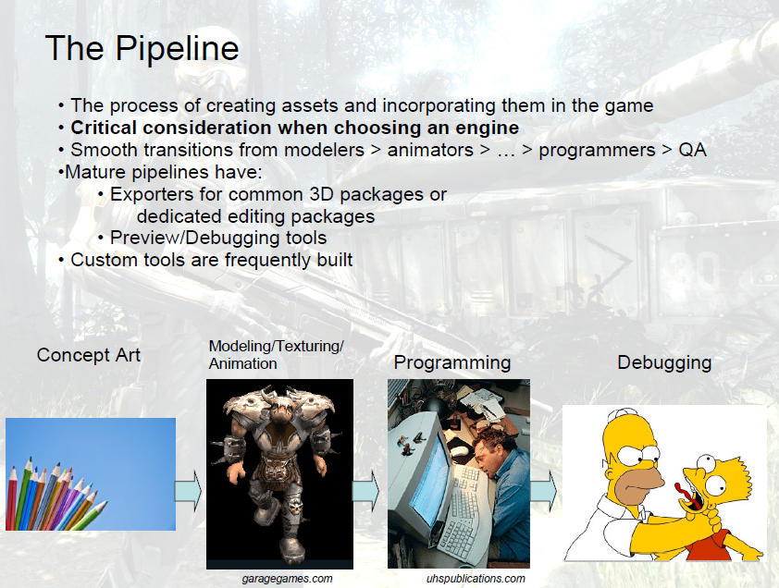
© B.Very Christioko, S.Kom

Slide 26
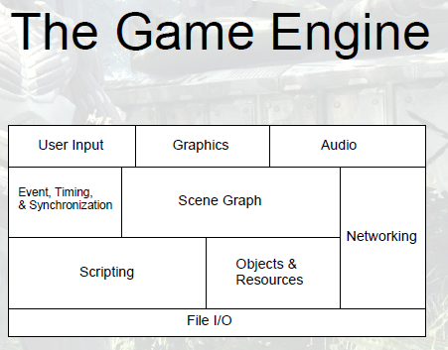
© B.Very Christioko, S.Kom

Slide 27
Game Engine ≠ Graphics Engine
© B.Very Christioko, S.Kom

Slide 28
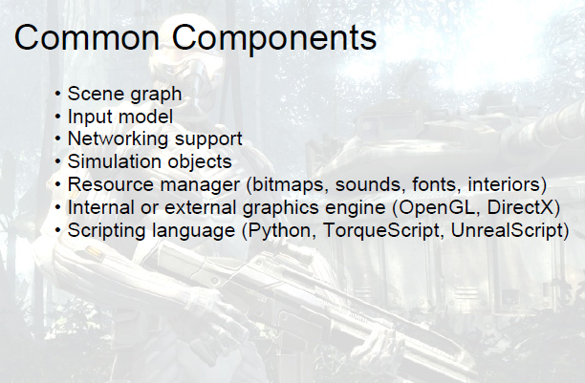
© B.Very Christioko, S.Kom

Slide 29
Game Maker
Game Engine
© B.Very Christioko, S.Kom

Slide 30
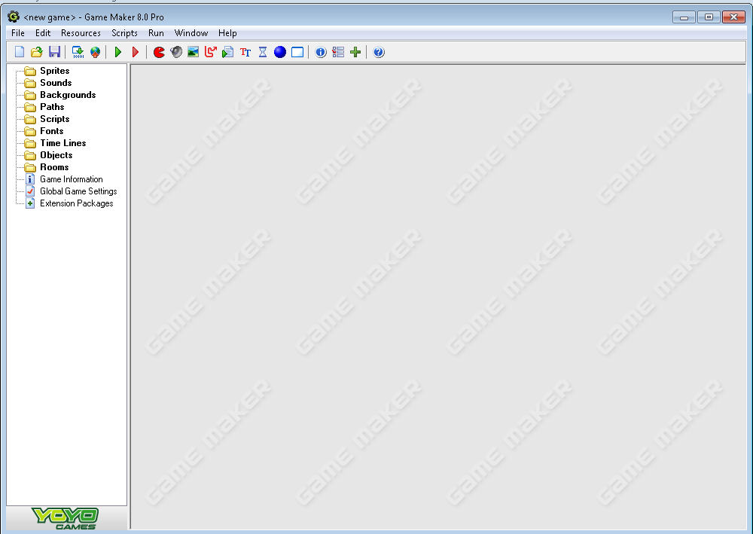
Game Maker 8.0
© B.Very Christioko, S.Kom

Slide 31
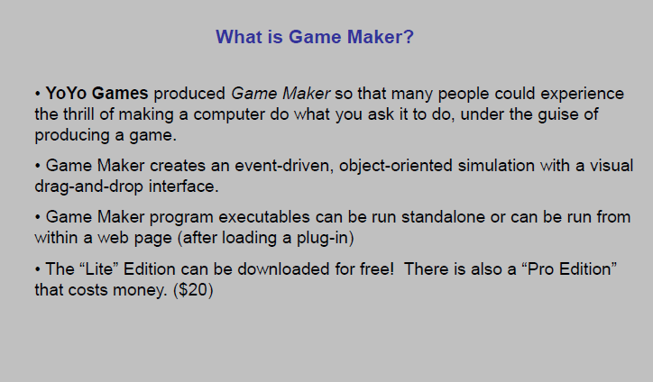
© B.Very Christioko, S.Kom

Slide 32
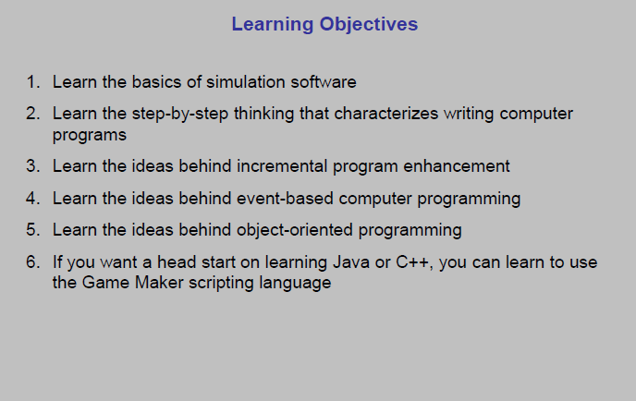
© B.Very Christioko, S.Kom

Slide 33
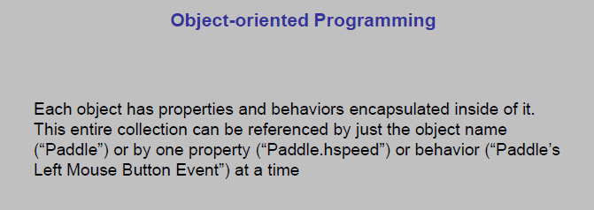
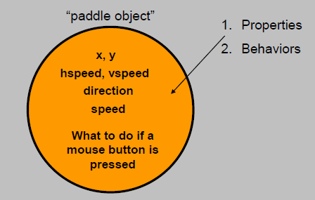
© B.Very Christioko, S.Kom

Slide 34
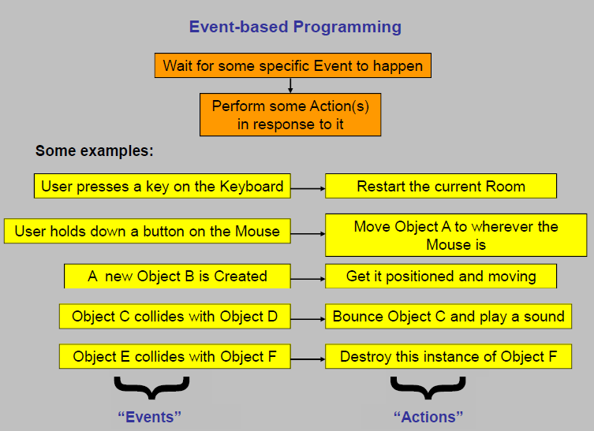
© B.Very Christioko, S.Kom

Slide 35
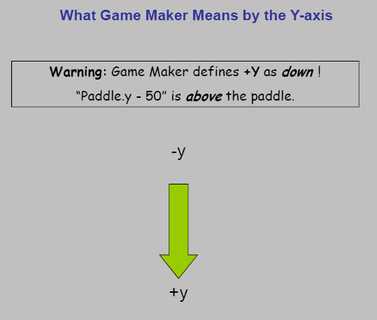
© B.Very Christioko, S.Kom

Slide 36
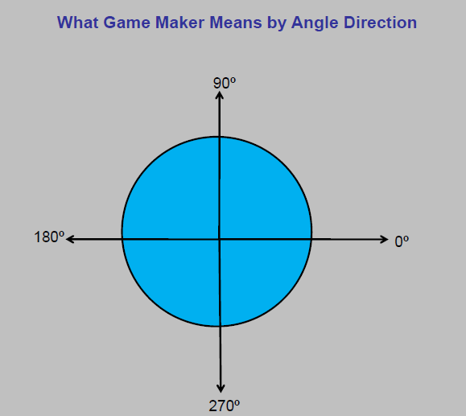
© B.Very Christioko, S.Kom

Slide 37
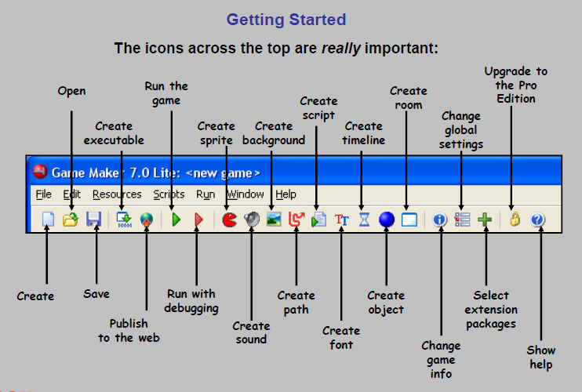
© B.Very Christioko, S.Kom

Slide 38
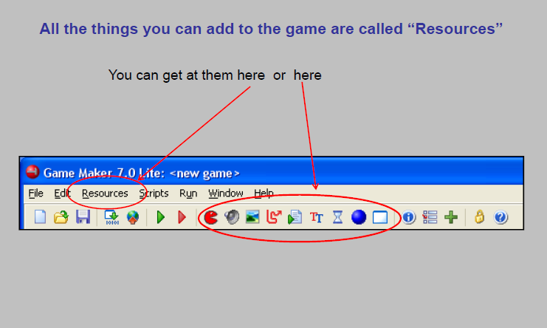
© B.Very Christioko, S.Kom

Slide 39
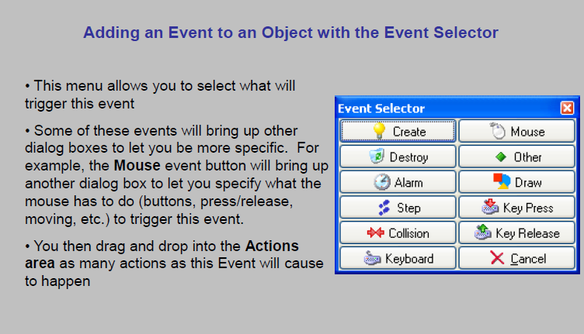
© B.Very Christioko, S.Kom

Slide 40
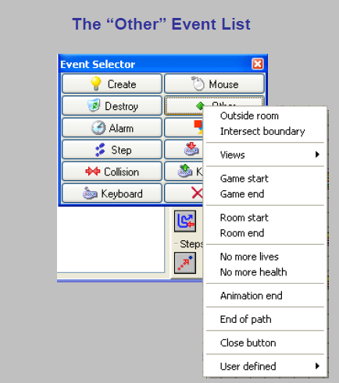
© B.Very Christioko, S.Kom

Slide 41
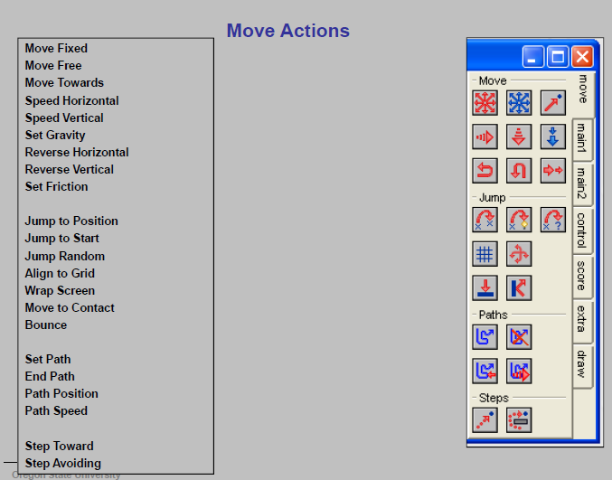
© B.Very Christioko, S.Kom

Slide 42
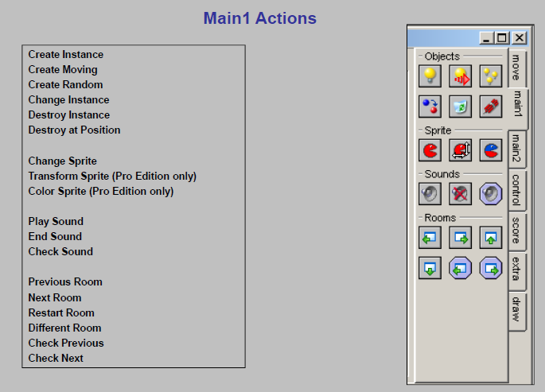
© B.Very Christioko, S.Kom

Slide 43
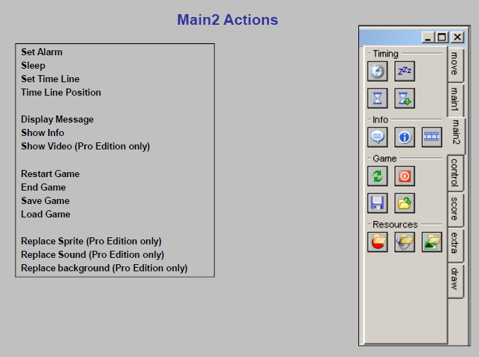
© B.Very Christioko, S.Kom

Slide 44
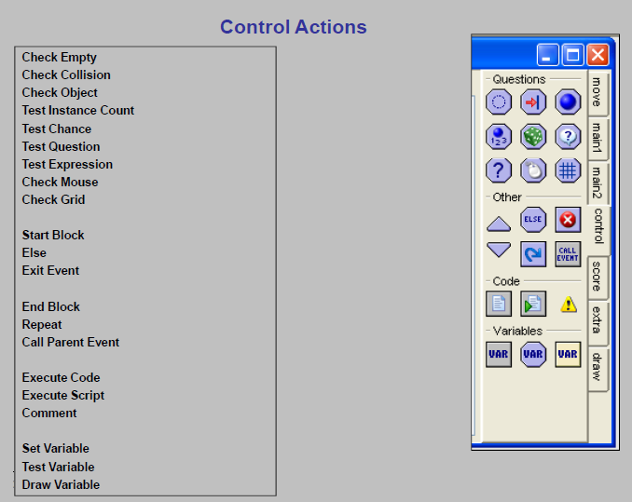
© B.Very Christioko, S.Kom

Slide 45
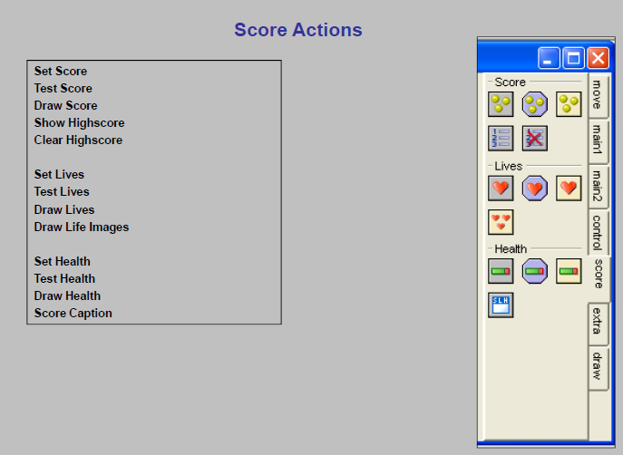
© B.Very Christioko, S.Kom

Slide 46
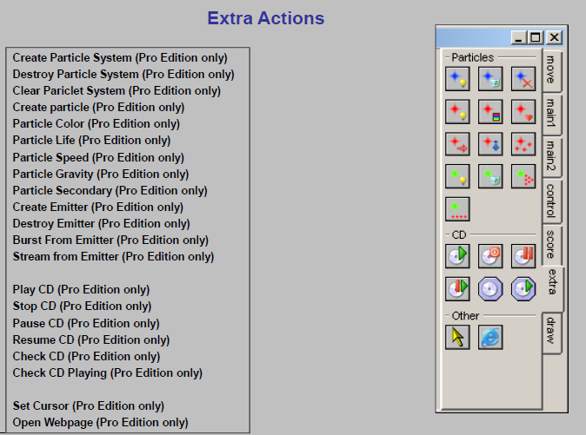
© B.Very Christioko, S.Kom

Slide 47
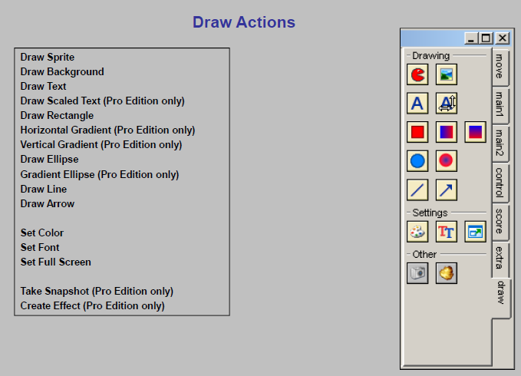
© B.Very Christioko, S.Kom

Slide 48
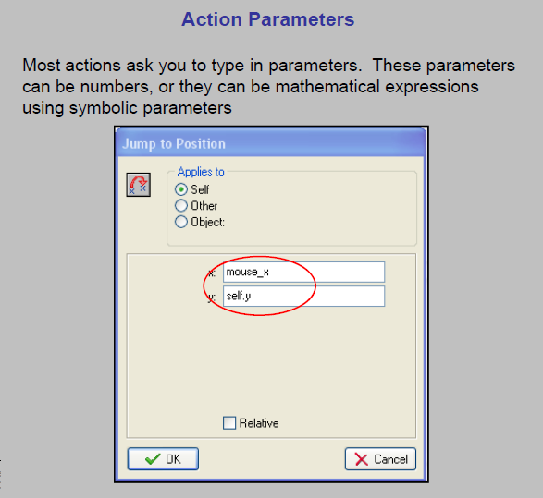
© B.Very Christioko, S.Kom

Slide 49
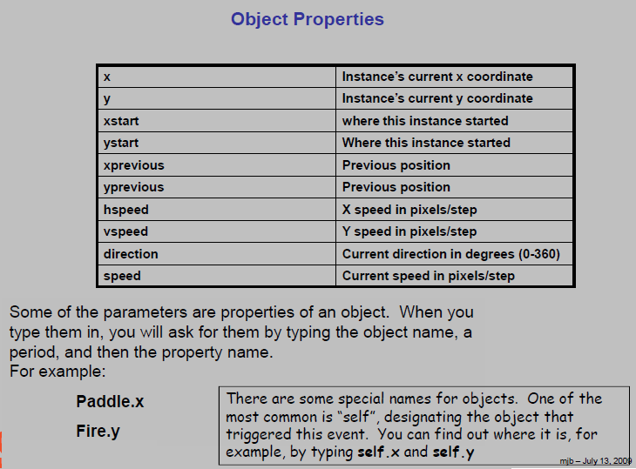
© B.Very Christioko, S.Kom

Slide 50
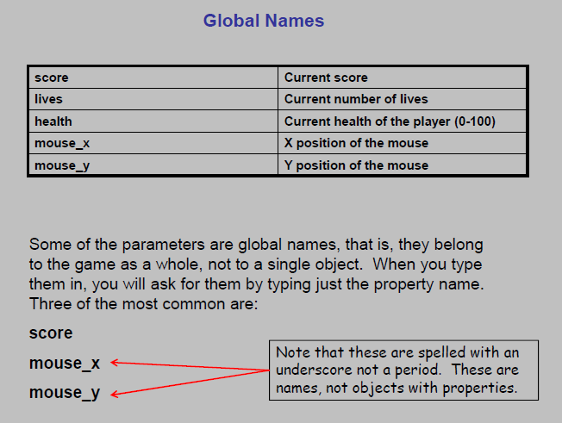
© B.Very Christioko, S.Kom

